Slide 1
Preparations for
2013-2014 Flood Season
DFM Flood Maintenance Office
Friday December 20, 2013
Presented By: Noel Lerner, Former Chief
Flood Maintenance Office
Division of Flood Management
California Department of Water Resources

Slide 2



Sacramento River Flood Control System
2013-2014
Flood Season Preparation
Routine maintenance of the Sacramento River Flood Control System including:
Central Valley Flood Protection Plan (CVFPP) Implementation
Deferred non-routine maintenance projects including:
Channel Clearing
Maintenance Yard Operations
Flood Control Facility Maintenance
Levee Maintenance
Channels
Levee Rehabilitation and Repair
Flood Control Facility Maintenance
Flood System Maintenance
CALIFORNIA
DEPARTMENT OF WATER RESOURCES

Slide 3
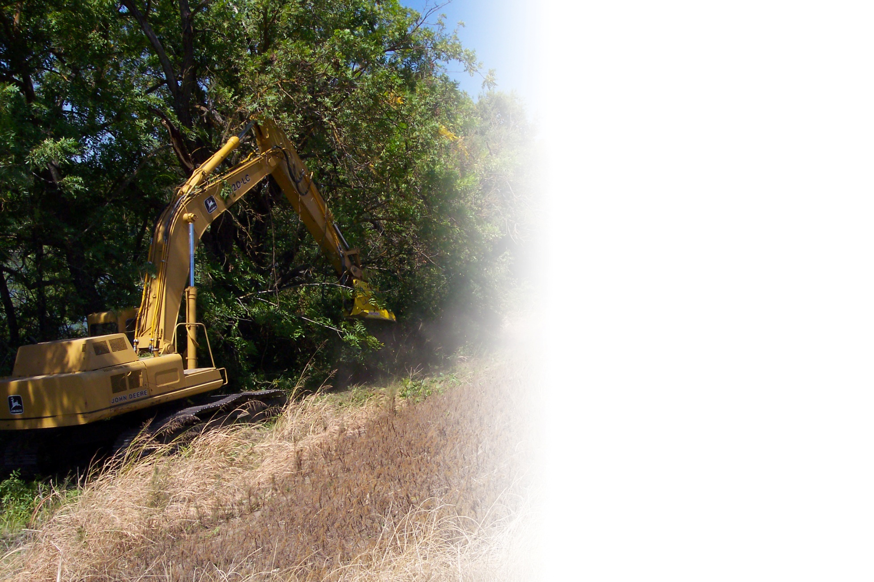
Sacramento River Flood Control System
Flood Season Preparation
Channel Clearing
A total of 4,194 acres of channels cleared of vegetation and debris
Screened 2,000 tons of gravel at Feather River Channel Pit
Removed beaver dams along: Cherokee Canal (24), Willow Slough (14), Linda Creek (3), and the Natomas East Main Drainage Canal (11)
Performed maintenance on 55 miles of seepage canals
CALIFORNIA
DEPARTMENT OF WATER RESOURCES

Slide 4
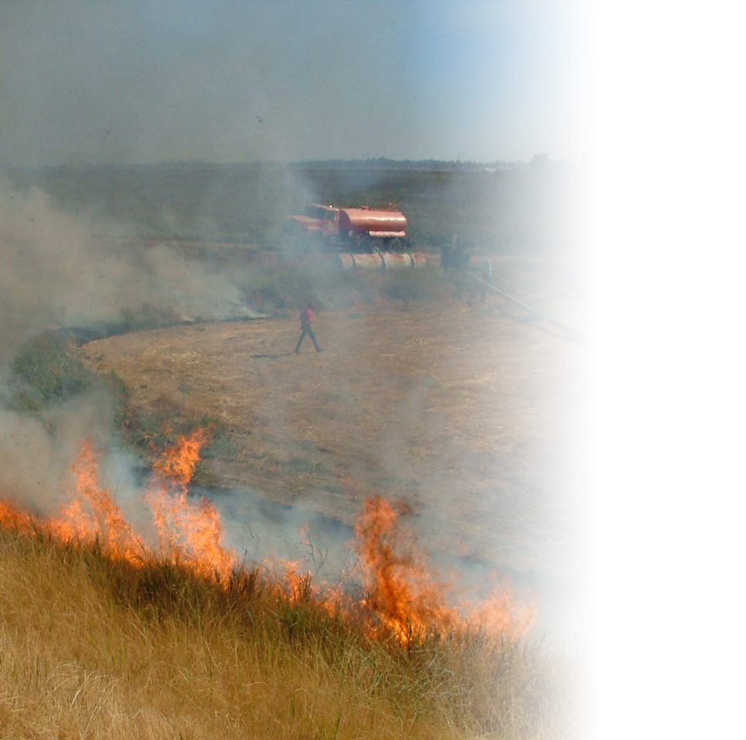
Sacramento River Flood Control System
Flood Season Preparation
Levee Maintenance
Repaired 8 levee erosion or stability sites
Repaired 9 beaver dens
Implemented rodent control (grout, bait and trap) along approximately 353 miles of levee
Completed approximately 521 miles of vegetation removal from levee slopes (mowing, burning)
Performed crown roadway maintenance along approximately 114 miles of levees
Performed approximately 293 miles of levee pipe inspections and repaired 5 pipes
CALIFORNIA
DEPARTMENT OF WATER RESOURCES

Slide 5
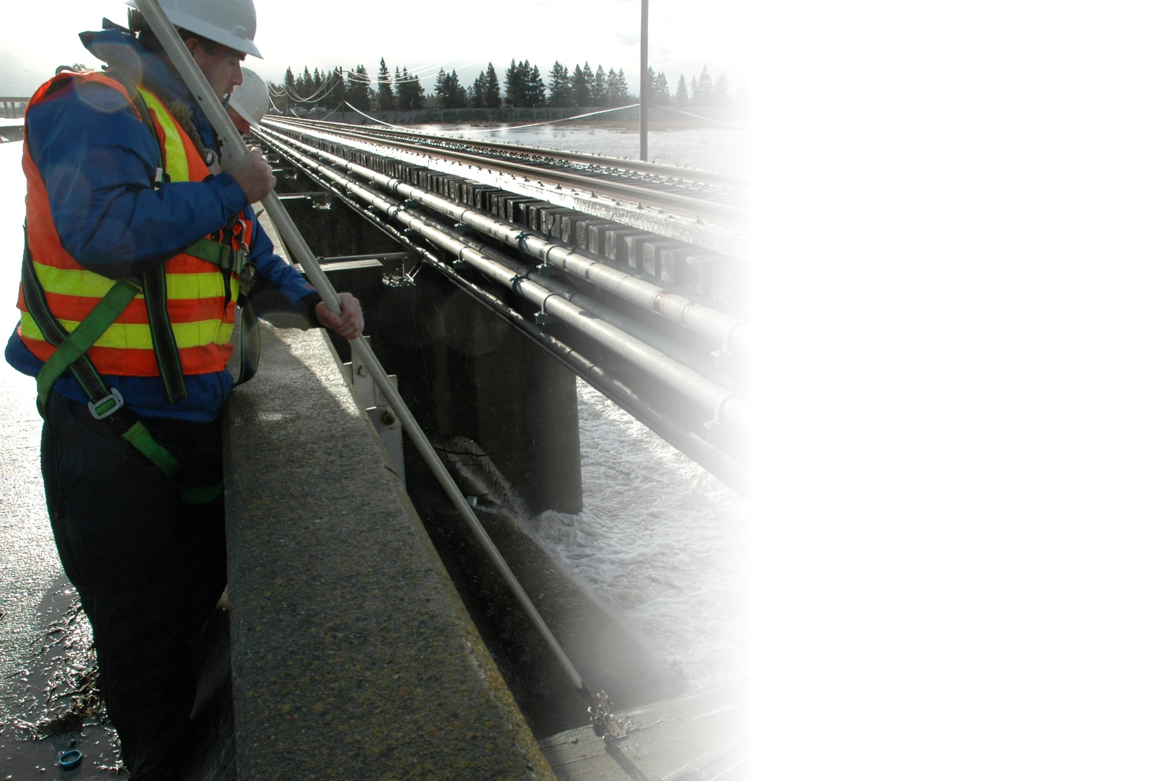
Sacramento River Flood Control System
Flood Season Preparation
Flood Control Facility Maintenance
Repaired a bridge on West Interceptor Canal
Cleaned out low flow channel at Cache Creek settling basin
Performed all maintenance on Butte Slough and Knights Landing Outfall Gates
Sacramento Weir maintenance completed on all 48 bays
Sutter Pumping Plants (and related collecting canals) cleared of debris
Inspected all DWR maintained structures and developed repair plans
CALIFORNIA
DEPARTMENT OF WATER RESOURCES

Slide 6
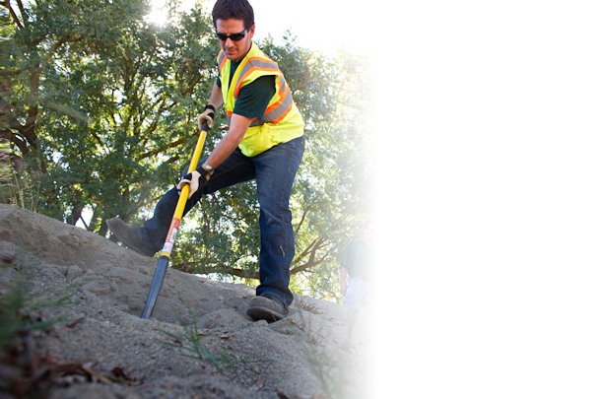
Sacramento River Flood Control System
Flood Season Preparation
Maintenance Yard Operations
Replenished flood material stockpiles
Remodeled mobile equipment shop
Completed concrete repairs
Installed video conferencing capabilities
Continued safety training
  Weekly tailgate safety talks
  Quarterly safety meetings
  All PPE (Personal Protective Equipment) inspected and updated
CALIFORNIA
DEPARTMENT OF WATER RESOURCES

Slide 7
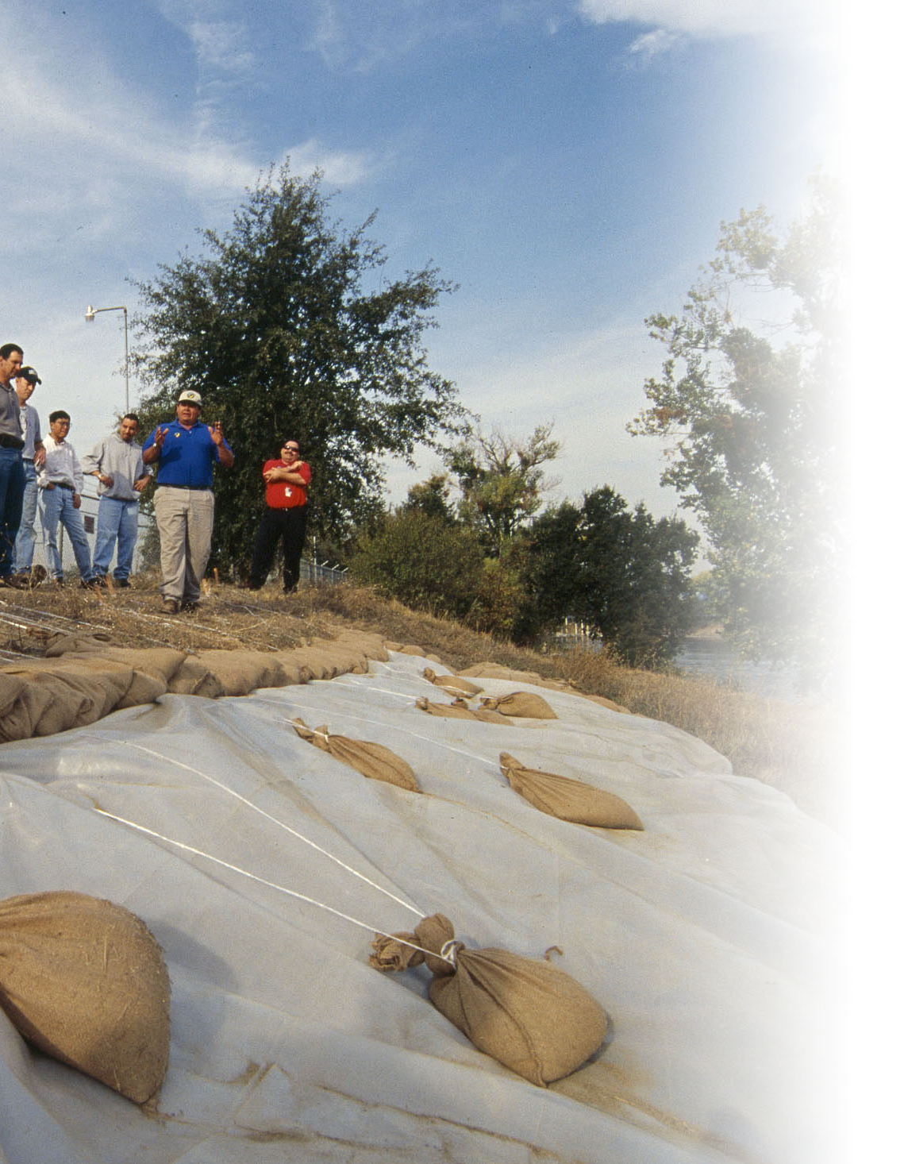
Sacramento River Flood Control System
Flood Season Preparation
Maintenance Yard Operations (Cont.)
All yard staff up-to-date on flood season preparedness training
  Flood Operations Center Response
  Flood Fight Methods
  Personnel Safety
  Levee Patrol Logistics
  High-Water Staking
  Event Documentation
CALIFORNIA
DEPARTMENT OF WATER RESOURCES

Slide 8
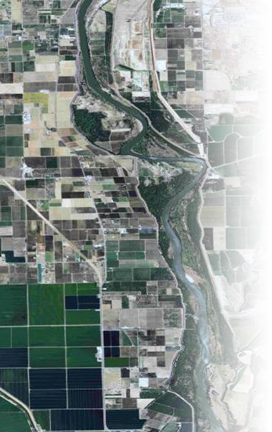
Sacramento River Flood Control System
CVFPP Implementation
Channels
Lower Feather River Corridor Management Plan (LFRCMP)
  Implemented an integrated strategy and long-term vision for managing the river corridor between Yuba City/Marysville and the Sutter Bypass
  Facilitates and promotes:
    Flood protection system management
    Maintenance of flood control facilities
    Restoration and enhancement of ecosystem functions and habitats
CALIFORNIA
DEPARTMENT OF WATER RESOURCES

Slide 9
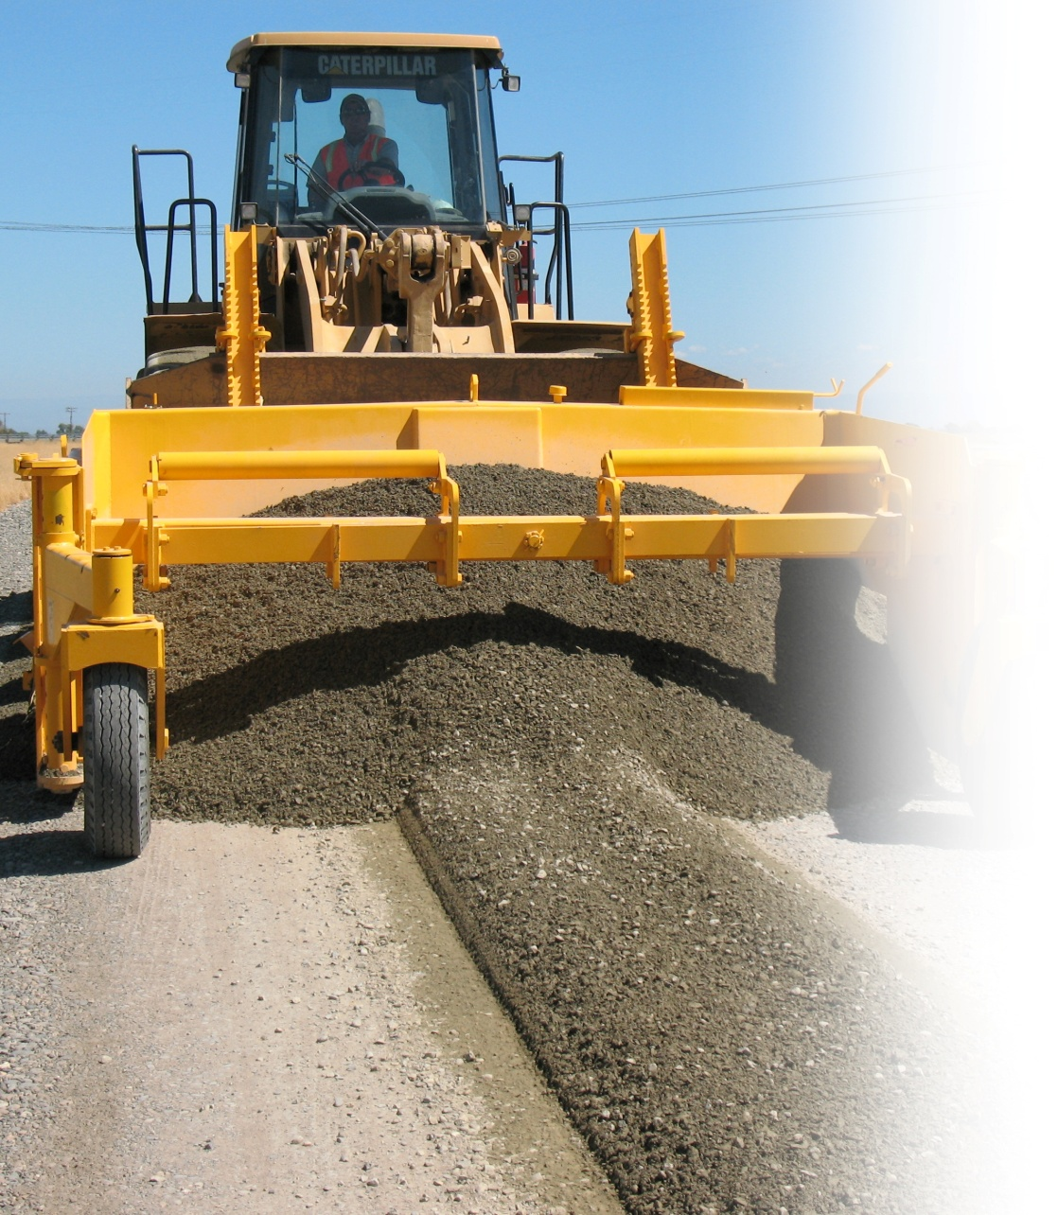
Sacramento River Flood Control System
CVFPP Implementation
Levee Rehabilitation and Repair
        Flood System Repair Project (FSRP)
        Completed reconnaissance efforts to identify and/or verify eligible sites
        Completed guidelines to cost-share projects in rural/agricultural areas for critical repairs to flood control facilities and levee patrol roads
        Rural Levee Repair Criteria (RLRC)
        Continued to provide guidance for repairs of smaller-scale levee deficiencies in rural/ agricultural areas
CALIFORNIA
DEPARTMENT OF WATER RESOURCES

Slide 10
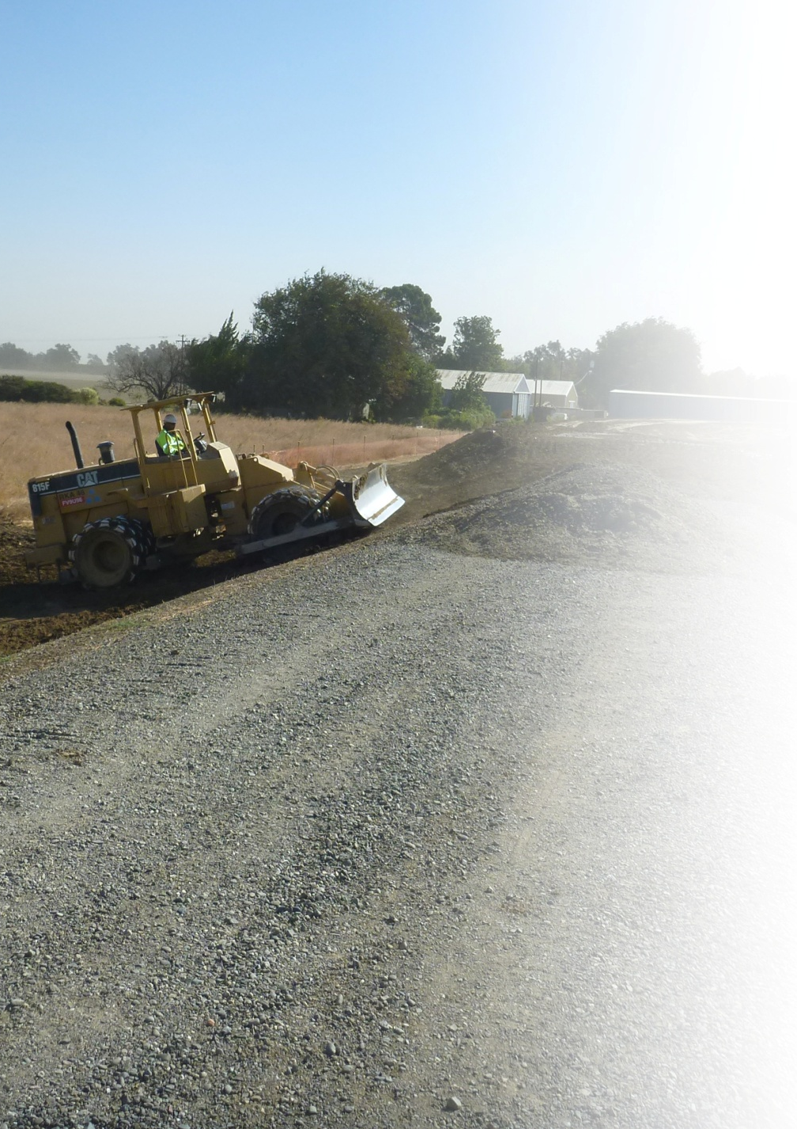
Sacramento River Flood Control System
CVFPP Implementation
Levee Rehabilitation and Repair (Cont.)
        Sacramento River Bank Protection Project (SRBPP)
        Continued design and real estate activities for 7 erosion repair sites on the Sacramento River
        Constructed 2 setback levees along Cache Creek
        Continued design and real estate activities for 2 additional setback levees along Cache Creek
        Continued work towards USACE authorization of an additional 80,000 linear feet of erosion repair under the current Project
CALIFORNIA
DEPARTMENT OF WATER RESOURCES

Slide 11
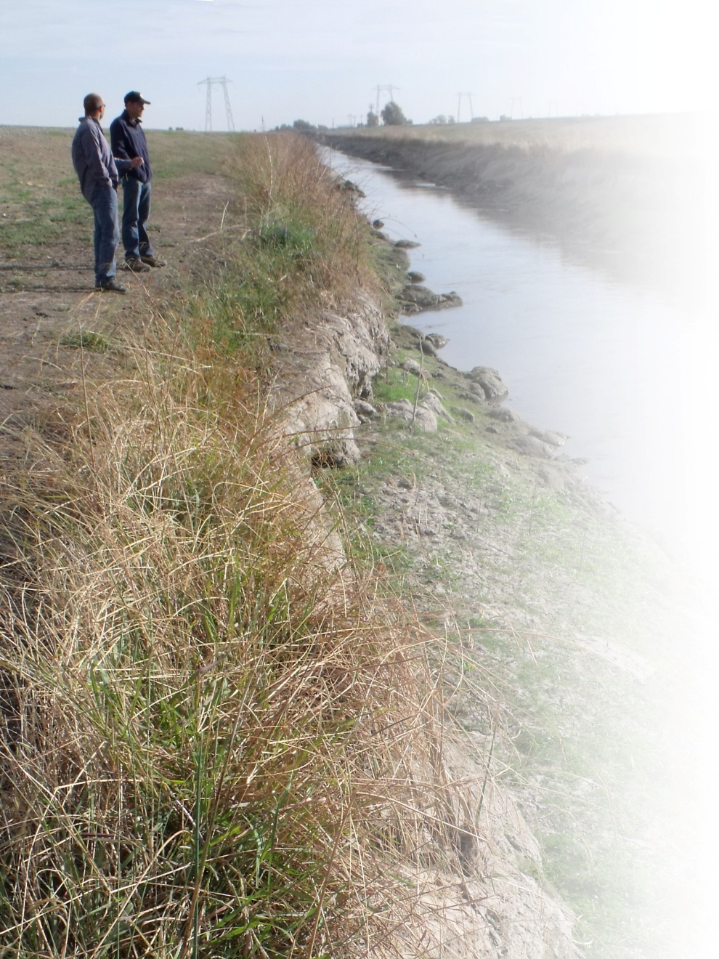
Sacramento River Flood Control System
CVFPP Implementation
Levee Rehabilitation and Repair (Cont.)
        Small Erosion Repair Program (SERP)
        Assigned federal Regional General Permit Number 9
        Completed Biological Opinions from the U.S. Fish and Wildlife Service and the National Marine Fisheries Service
        Identified 20 potentially SERP-eligible sites
        Levee Stability Program
        Completed 850 feet partial levee replacement and stability berm at RD 1001
        Completed 2,000 feet of erosion protection at RD 2064
CALIFORNIA
DEPARTMENT OF WATER RESOURCES

Slide 12
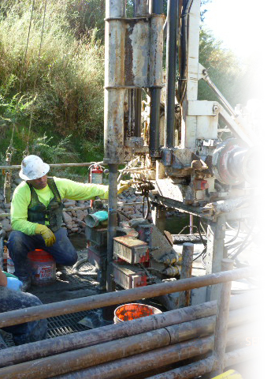
Sacramento River Flood Control System
CVFPP Implementation
Flood Control Facilities Rehabilitation and Repair
Sutter Bypass Pumping Plant Rehabilitation Project
  Installed back-up electrical generation systems at each of 3 pumping plants
  Installing SCADA system to automate control of the facilities from the Sutter Maintenance Yard (projected to be complete prior to the end of this fiscal year)
Butte Slough Outfall Gates (BSOG)
  95 % design completed by DOE
CALIFORNIA
DEPARTMENT OF WATER RESOURCES

Slide 13
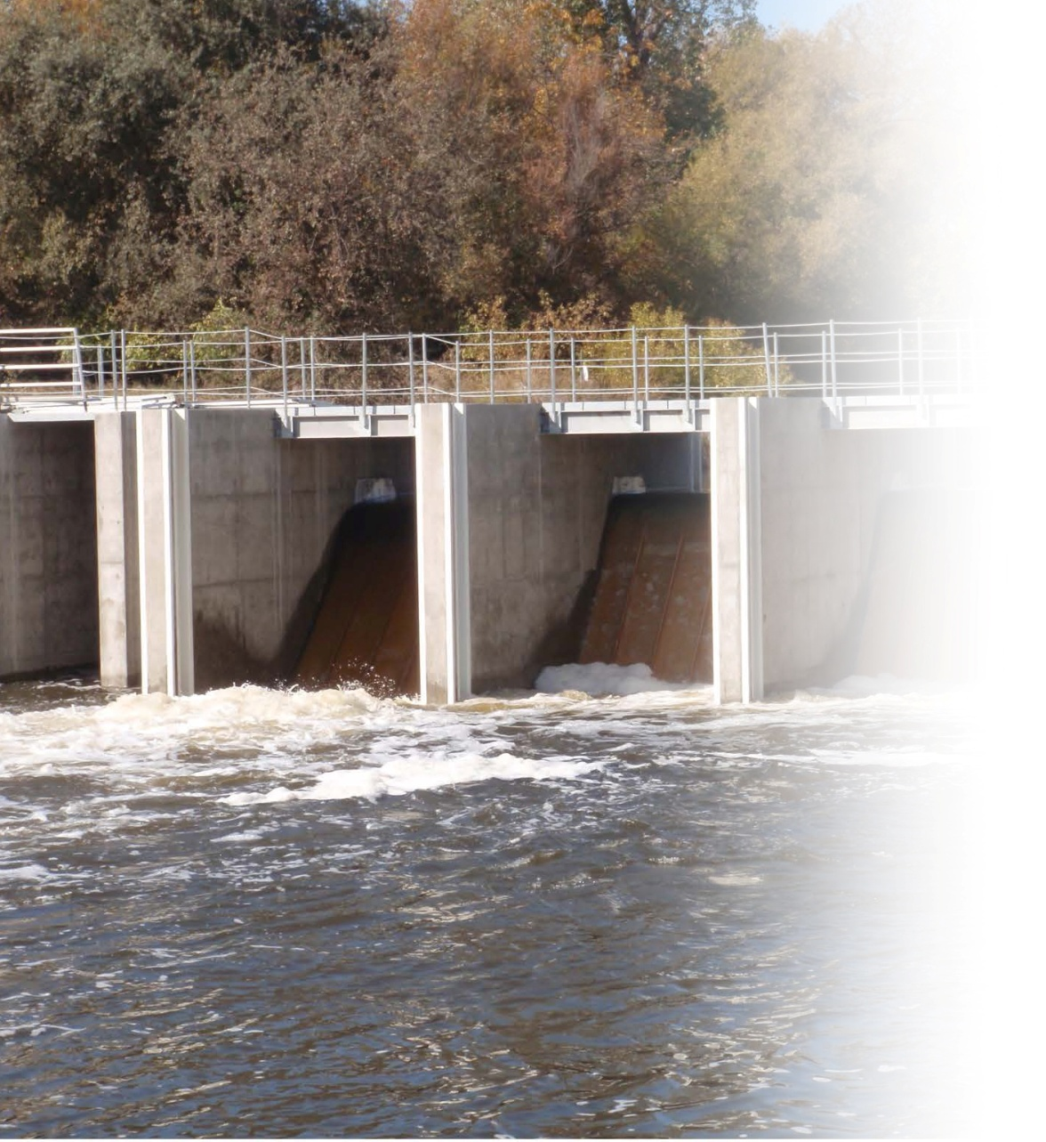
Sacramento River Flood Control System
CVFPP Implementation
Flood Control Facilities Rehabilitation and Repair (Cont.)
Sutter Bypass East Borrow Canal (Weir No. 2)
  Completed construction of new weir and fish ladder
  New weir allows remote real-time adjustment to water surface elevations through satellite connection to control building
CALIFORNIA
DEPARTMENT OF WATER RESOURCES

Slide 14
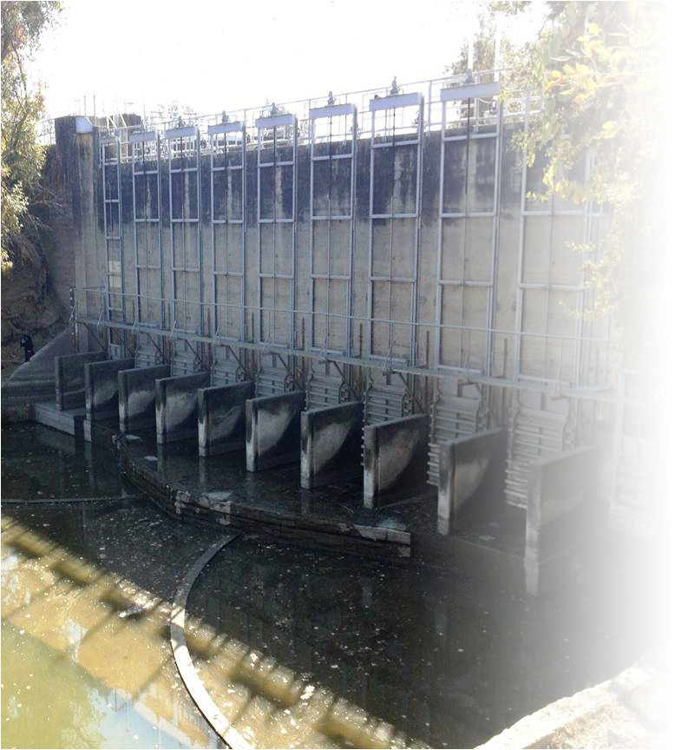
Sacramento River Flood Control System
CVFPP Implementation
Flood Control Facilities Rehabilitation and Repair (Cont.)
Knights Landing Outfall Gates Rehabilitation
  20 new gates replaced with new motors for the upstream slide gates
  An updated automation system maintains a set upstream water surface elevation
  Communications through CDEC monitors water surface elevation, gate operations, and alarms
CALIFORNIA
DEPARTMENT OF WATER RESOURCES

Slide 15
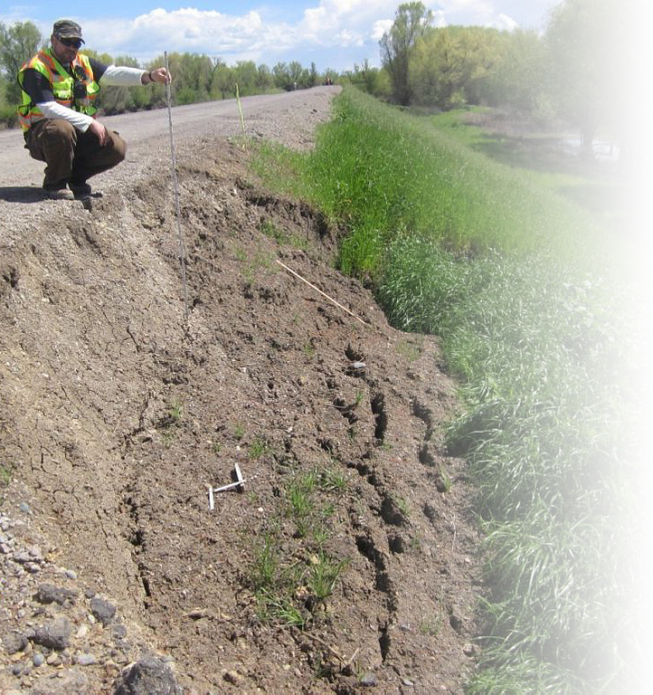
Sacramento River Flood Control System
CVFPP Implementation
Flood System Maintenance
Revising Superintendents Guide to O&M
Developed database to log and track the status of inspections done by both DWR and USACE during routine and periodic inspections
CALIFORNIA
DEPARTMENT OF WATER RESOURCES

Slide 16
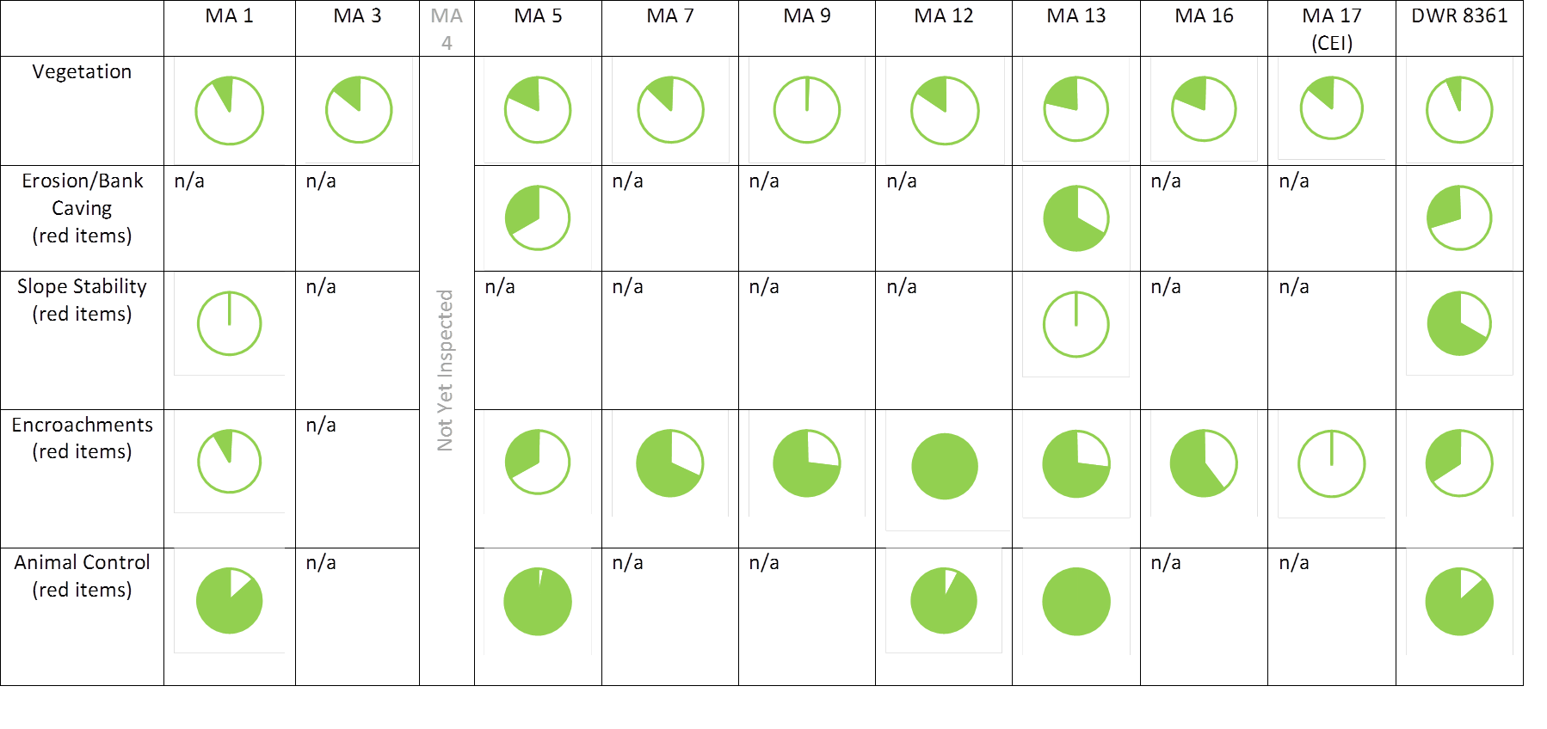
Sacramento River Flood Control System
2013-2014
Corrective Actions for USACE Inspection Points
CALIFORNIA
DEPARTMENT OF WATER RESOURCES

